Slide 1

Gasoline Production Predictions
Manash Kumar Mondal
161-15-7245

Slide 2
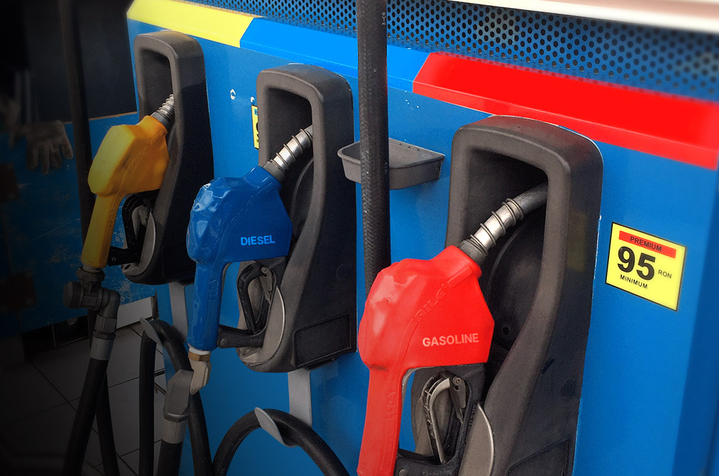
Introduction
Gasoline is economic backbone of many countries
So production predictions are more important
Regression is a method for predictions of future value

Slide 3

Literature Review
Build a model for predicting the gasoline production
Test it using test set and
Find R-Squared Value

Slide 4
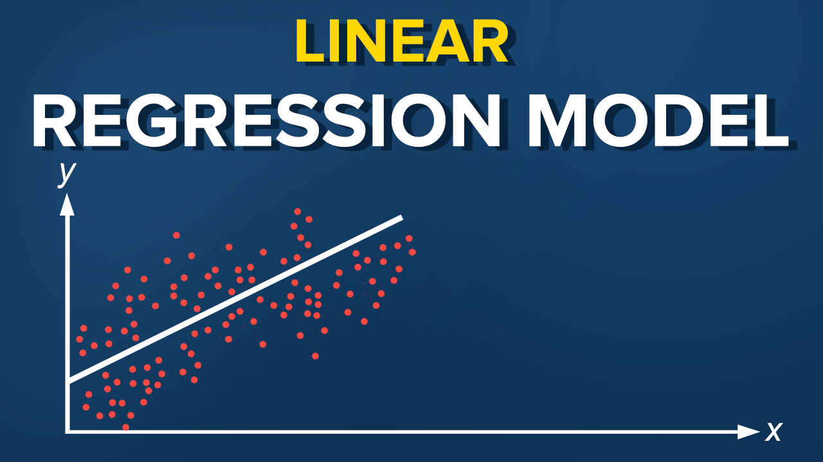
Method

Slide 5
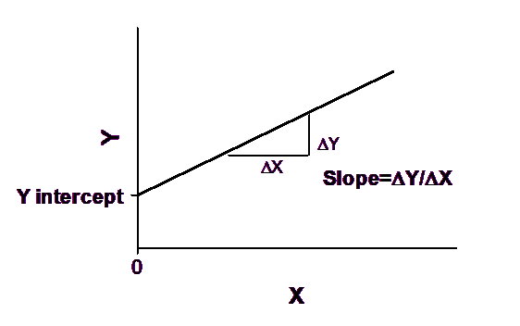
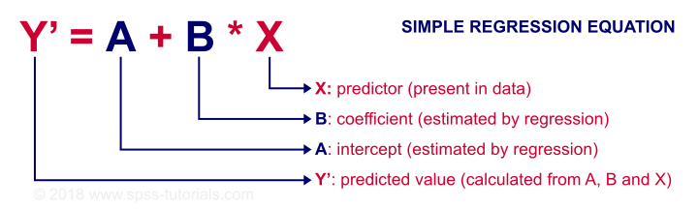
What is Linear Regression ?
Y = mx + c

Slide 6
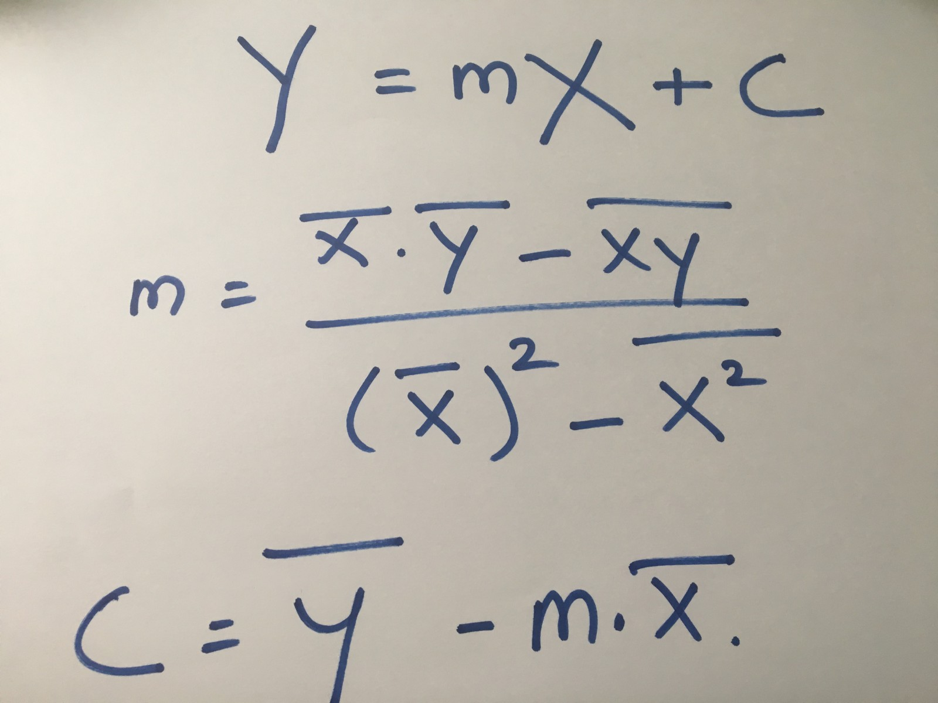
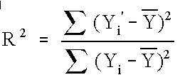
Formula

Slide 7
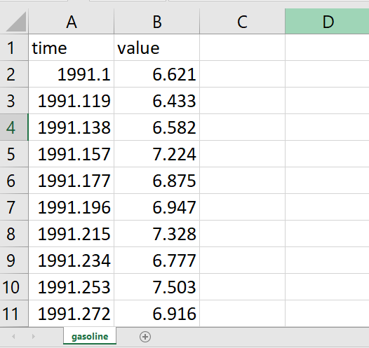
DataSet
US finished motor gasoline product supplied
Filename: gasoline.csv
2 Columns ( time, value )
1355 rows
All Numeric
No missing value

Slide 8
Steps
Import dataset
Import libraries
Splitting dataset ( Training & Test ) in 2 : 1 ratio
Then done Regression
Plotting data in graph
Find m, C, R-squared value

Slide 9
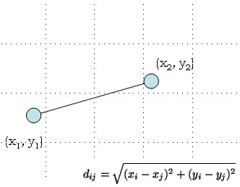
Point to be noted
# Don’t need
to take care of missing value
Encoding categorical Data
Feature Scaling

Slide 10
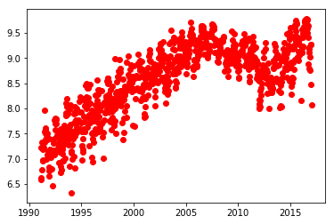
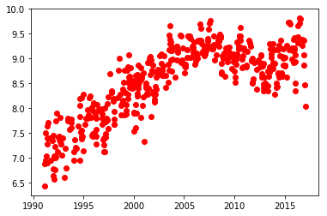
Data
Training
Test

Slide 11
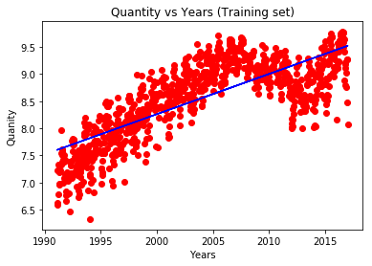
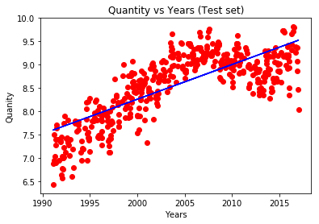
Data
Training
Test

Slide 12
Final Result
Y = mx + C
=> Y = 0.07421111 x + ( -140.16189272125573 ) called Best Fit Line
R^2 = 0.6008860874144708
60 %

Slide 13
Reference
[1] https://vincentarelbundock.github.io/Rdatasets/datasets.html
[2] Google.com (images)
Thank you

